Slide 1
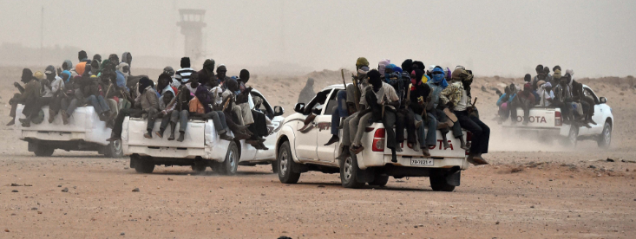
West African Migration Secondary Data Needs Assessment
Catholic Relief Services (CRS)
West Africa Regional Office (WARO)
Sarah Simpkins

Slide 2
Background

Slide 3
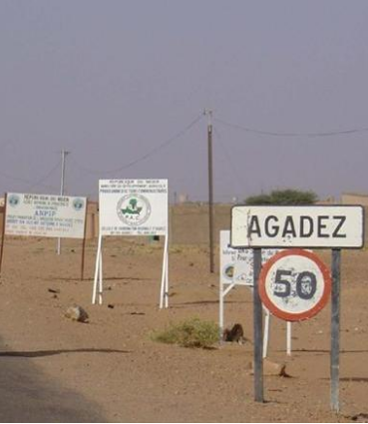
Research Questions
Objective: Identify potential programmatic responses and information gaps for primary-data collection
Trends and migrant profiles
Relationship to conflict, youth, gender and climate
Policy environment & programmatic responses
Gaps in information, services, and donor funding

Slide 4
Desk Research
Key word search
Web crawlers
Country Consultations
Expert Interviews
World Bank
Texas A&M
CRS West Africa Offices
Methodology

Slide 5
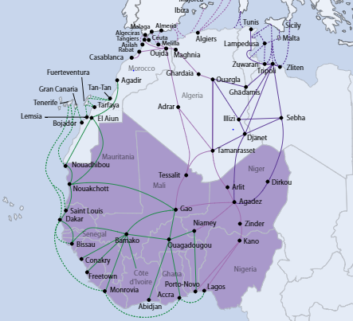
Coastal or Atlantic Route: By boat to Canary Islands or through Morocco to Spain
Sahara Route: From major cities in West Africa to Libya or Algeria via Gao in Mali or Agadez in Niger
Route mostly legal up until Gao and Agadez
Migration Trends

Slide 6
Migration Trends

Slide 7
Source: Missing Migrants Project 2017, IOM
Migrant Profiles

Slide 8
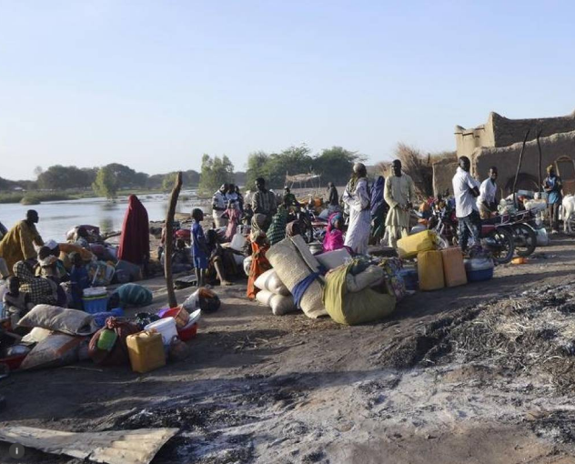
Unemployment: Around 43 percent of men unemployed and 51 percent of women
Demographics: 1/3 of population is between 10 and 24
Population Growth: West Africa expected to reach 815 million people by 2050
Climate Change: 19 designated “hot spots” in West Africa susceptible to natural disasters
Conflict: Exasperates pre-existing push factors
Push Factors
Picture of Lake Chad Basin in Niger, Chad, and Nigeria now 1/20th of former size

Slide 9
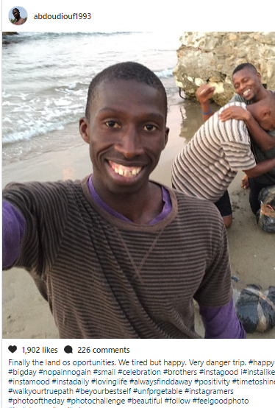
Pull Factors
Inability to fulfill social and societal expectations
Desire to increase family/household status through remittances
Increased access to ICT and social media platforms such as Instagram, Facebook, Viper & WhatsApp
“
One friend would phone me, telling me that Europe is a thousand times better than Africa. I looked on Facebook, I saw the nice pictures – it drove me to go.” – Migrant from Senegal
“

Slide 10
Policy and Program Environment

Slide 11

Donor Priorities
$3.6B EUTF for Africa fund established during Valletta Summit on Migration in 2015
Priorities:
Address root causes of irregular migration
Enhance cooperation on legal migration
Reinforce the protection of migrants
Prevent and fight irregular migrant smuggling and trafficking
Improve cooperation on return, readmission and reintegration

Slide 12
Evaluation Criteria and Programmatic Responses
Programmatic Alternatives
Evaluation Criteria
Protection before departure
Protection of migrants on the move
Protection of migrants after return
Effectiveness
Financial realism
Technical feasibility
Donor acceptability
Sustainability
Cultural acceptance

Slide 13
Recommendations

Slide 14

Protection before Departure
Push Factors
Reliable tips and advise will promote migrant safety
Migrants more likely to trust information that is not deterrent based
Possible activities: sensitization campaigns, community discussions, radio spots
Address household drivers
Promote safe & viable livelihoods
Provide accurate & reliable information

Slide 15
Protection of Migrants on the Move
Migrants who run out of money during the journey may be drawn into exploitative activities
Lack of transferable skills is a barrier for potential returnees
Possible activities: Market-based IGAs, provide information on common schemes/traps in transit zones, support language/skill acquisition for migrants heading onwards
Data collection on migrants in transit
Scale-up PSS and medical support
Build capacity of duty-bearers
Promote safe labor and access to education

Slide 16
Protection of Migrants After Return
Fear of returning “empty-handed”
Lack of empathy for “failed returnees”
Stigmatization of victims of trafficking/sexual assault
Possible activities: Community dialogues, information campaigns household visits to support reintegration process
Promote assisted voluntary returns
Reduce returnee stigma

Slide 17

Level of Income/Financing
Where is the general income level of migrants?
Where do they get money to finance their trip?
Gender & Unaccompanied children
Why are there more women and unaccompanied children migrating?
What are their motivations?
Occupation before Departure
What did migrants do for a living before departure?
What do they expect to do after migrating?
Education Level
What is the highest level of education obtained?
How does this vary by gender?
Information Gaps

Slide 18
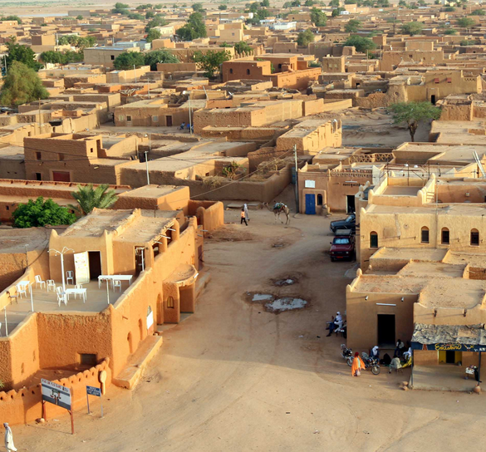
Questions?

